Slide 1
POLYMORPHISM
https://www.youtube.com/watch?v=EejEQCgxIKM&list=PLoSDia_xPJ5qFeeU_cQLBgfJiJdaZJBkk

Slide 2
Polymorphism
Polymorphism is the ability of an object or reference to take many different forms at different instances.
These are of two types :
  compile time polymorphism
  run-time polymorphism

Slide 3
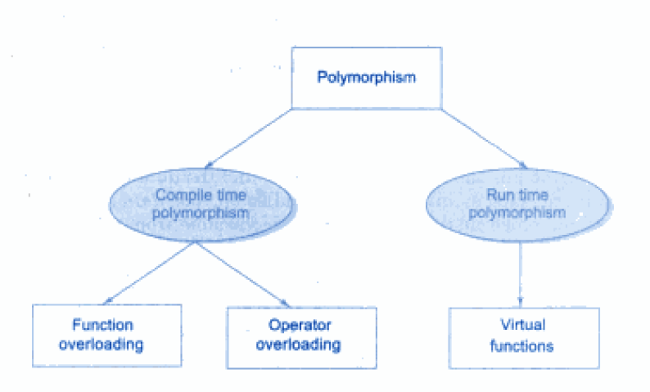
Polymorphism

Slide 4
TYPES OF POLYMORPHISM
Compile time polymorphism: In this method object is bound to the function call at the compile time itself.
Run time polymorphism: In this method object is bound to the function call only at the run time.

Slide 5
Compile time Polymorphism | Run time Polymorphism
It is also known as Static binding, Early binding and overloading as well. | It is also known as Dynamic binding, Late binding and overriding as well.
Overloading is compile time polymorphism where more than one methods share the same name with different parameters or signature and different return type. | Overriding is run time polymorphism having same method with same parameters or signature, but associated in a class & its subclass.
It is achieved by function overloading and operatoroverloading. | It is achieved by virtual functions and pointers.
It provides fast execution because known early at compile time. | It provides slow execution as compare to early binding because it is known at runtime.
Compile time polymorphism is less flexible as all things execute at compile time. | Run time polymorphism is more flexible as all things execute at run time.

Slide 6
EXAMPLE: Complile time
class A
{
public:
void func(int x)
{
cout << "value of x is " << x <<endl;
}
void func(double x)
{
cout << "value of x is " << x <<endl;
}
void func(int x, int y)
{
cout << "value of x and y is " << << ", " << y << endl;
}
};
int main() {
A obj1;
obj1.func(7);
obj1.func(9.132);
obj1.func(85,64);
return 0;
}

Slide 7
EXAMPLE
int area ()
{
cout << "Rectangle class area :" <<endl;
return (width * height);
} };
class Triangle: public Shape
{
public:
Triangle( int a=0, int b=0):Shape(a, b)
{ }
int area ()
{
cout << "Triangle class area :" <<endl;
return (width * height / 2);
} };
// Main function for the program
int main( )
{
Shape *shape;
Rectangle rec(10,7);
Triangle tri(10,5);
shape = &rec; // store the address of Rectangle
shape->area(); // call rectangle area.
shape = &tri; // store the address of Triangle
shape->area(); // call triangle area.
return 0;
}
#include <iostream>
class Shape
{
protected:
int width, height;
public:
Shape( int a=0, int b=0)
{
width = a;
height = b;
}
int area()
{
cout << "Parent class area :" <<endl;
return 0;
} };
class Rectangle: public Shape
{
public:
Rectangle( int a=0, int b=0): Shape(a, b)
{ }

Slide 8
When the above code is compiled and executed, it produces the following result:
Parent class area
Parent class area
The reason for the incorrect output is that the call of the function area() is being set once by the compiler as the version defined in the base class.
This is called static resolution of the function call, or static linkage - the function call is fixed before the program is executed. This is also sometimes called early binding because the area() function is set during the compilation of the program.

Slide 9
Now if we precede the declaration of area() in the Shape class with the keyword virtual then:
class Shape
{
protected:
int width, height;
public:
Shape( int a=0, int b=0)
{
width = a;
height = b;
}
virtual int area()
{
cout << "Parent class area :" <<endl;
return 0;
} };

Slide 10
Now the output of the program will be:
Rectangle class area
Triangle class area
This time, the compiler looks at the contents of the pointer instead of it's type. Hence, since addresses of objects of tri and rec classes are stored in *shape the respective area() function is called.

Slide 11
Virtual function
When the same function name is used in the base and derived classes, the function in base class is declared as virtual using the keyword virtual preceding its normal declaration.
Virtual means existing in appearance but not in reality.
Virtual functions are used in late binding or dynamic binding.
The concept of pointers play important role in the virtual functions.
When a function is virtual, C++ determines which function to use at run time based on the type of object pointed to by the base pointer rather than the type of pointer.

Slide 12
The selection of the function to be called at any given point in the program to be based on the kind of object for which it is called. This sort of operation is referred to as dynamic linkage, or late binding.

Slide 13
BINDING
Binding refers to the process that is used to convert identifiers (such as variable and function names) into machine language addresses.
Early binding
Most of the function calls the compiler encounters will be direct function calls. A direct function call is a statement that directly calls a function. For example:
#include <iostream>
void PrintValue(int nValue)
{
cout << nValue;
}
int main()
{
PrintValue(5); // This is a direct function call
return 0;
}

Slide 14
Pure Virtual Function
A pure virtual function is a virtual function which has no body i.e no arguments, no variables and no expressions or statements inside it.
It's possible to declared a pure virtual function in a base class so that it may be redefined in a derived class to suit the objects of that class, but has no definition relative to the base class.

Slide 15
Why we use Pure virtual function??
To make the code simpler.
To access the members of derived class through the pointer of base class, we need virtual functions.
But if the virtual function is of no use, because it will not be called then we make it as pure virtual function.

Slide 16
Pure Virtual Function
Is a function without a body
Is created by adding the notation ‘=0’ to the virtual function declaration
Example:
virtual int calc_net_salary()=0;

Slide 17
Example
class shape
{
protected:
int a,b;
public:
void read()
{
cin>>a>>b;
}
virtual void cal_area()=0;
};
class rectangle:public shape
{
void cal_area()
{
double area=a*b;
cout<<area;
}
};
class triangle:public shape
{
void cal_area()
{
double area=(a*b)/2;
cout<<area;
}
};
int main()
{
shape *ptr[2];
rectangle r1;
cout<<“enter leng n bredth”;
r1.read();

Slide 18
Example
triangle t1;
cout<<“enter base n perpendicular”;
t1.read();
ptr[0]=&r1;
ptr[1]=&t1;
for(int i=0;i<2;i++)
ptr[i]->cal_area();
}
OUTPUT
Enter length and breadth 10 20
Enter base and perpendicular 5 20
Area of rectangle=200
Area of triangle=50

Slide 19
Abstract base class
The class in which at least one pure virtual function declared is called an abstract base class.
We can not create object of the abstract class, but we can create pointer to that class.
A class that does not have a pure virtual function is called a concrete class.

Slide 20
Virtual destructor
"A destructor is a member function of a class, which gets called when the object goes out of scope". This means all clean ups and final steps of class destruction are to be done in destructor.
The order of execution of destructor in an inherited class during a clean up is like this.
1. Derived class destructor
2. Base class destructor
In inheritance, when the object of the base class is deleted, the destructor for derived class does not get called at all.

Slide 21
#include <iostream.h>
class Base
{
public:
Base(){ cout<<"Constructor: Base"<<endl;}
~Base(){ cout<<"Destructor : Base"<<endl;}
};
class Derived: public Base
{
//Doing a lot of jobs by extending the functionality
public:
Derived(){ cout<<"Constructor: Derived"<<endl;}
~Derived(){ cout<<"Destructor : Derived"<<endl;}
};
void main()
{
Base *Var = new Derived();
delete Var;
}
OUTPUT: Constructing Base
Constructing Derive
Destroying Base

Slide 22
Virtual destructor
This problem can be fixed by making the base class destructor virtual and this will ensure that the destructor for any class that derives from base will be called.

Slide 23
Virtual destructor
class Base
{
public:
Base()
{
cout<<"Constructing Base";
}
// this is a virtual destructor:
virtual ~Base()
{
cout<<"Destroying Base";
} };
OUTPUT: Constructing Base
Constructing Derive
Destroying Derive
Destroying Base

